Slide 1
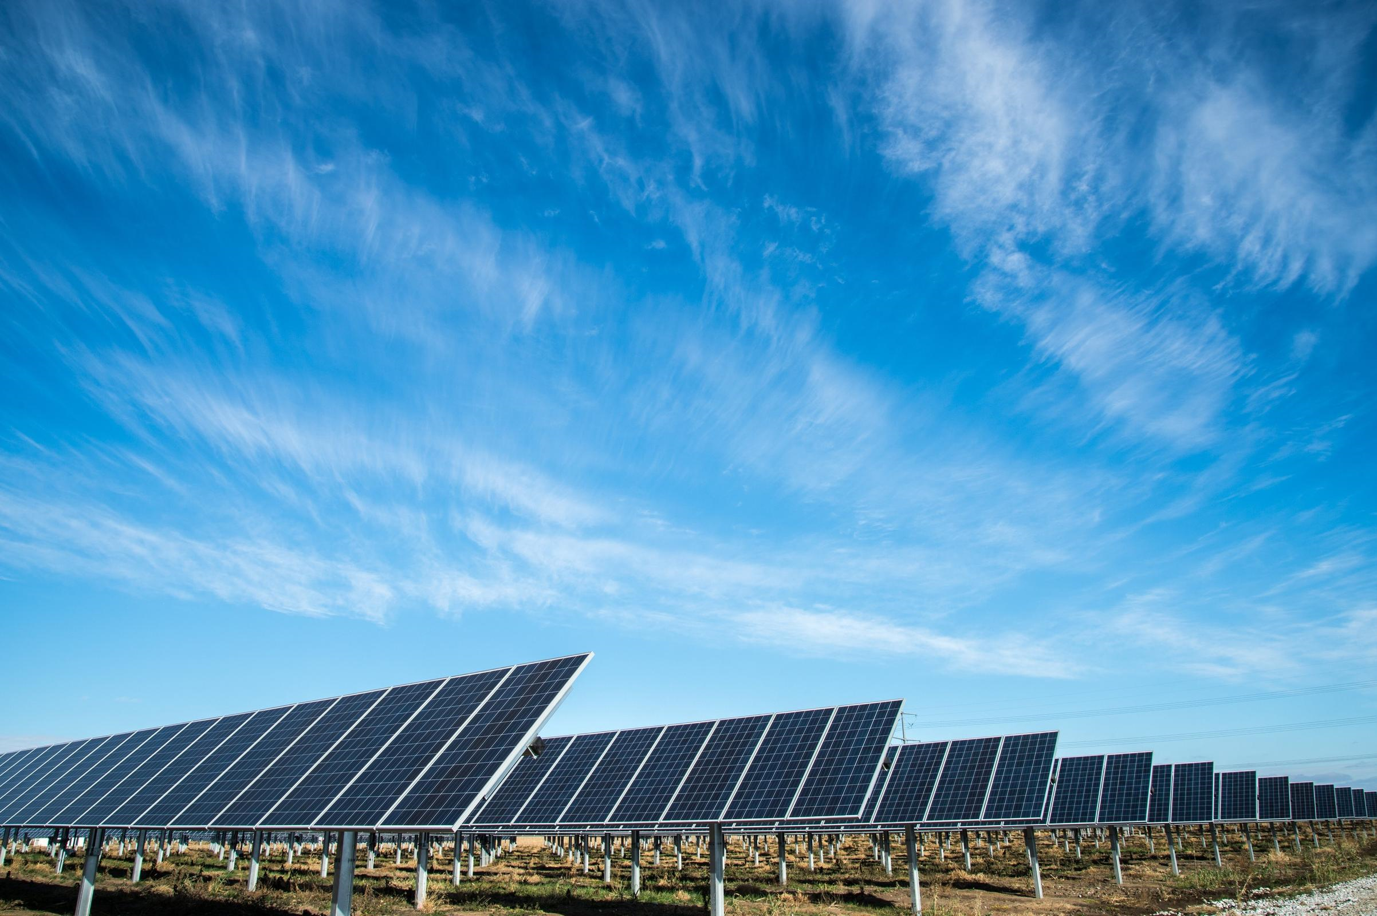
Team Zero
Amin Mansouri Jefry el Bhwash
Levy Duivenvoorden
Niels van Drunen
Niels van Schaik

Slide 2
Research Question
What is a suitable model to predict energy use and production of a “Zero At The Meter” dwelling, one day in advance with hourly resolution to maximize the profit for the user?
However…. 1. Is it possible to predict the energy use and production?
2. Is it advantagious to store some of the energy?

Slide 3
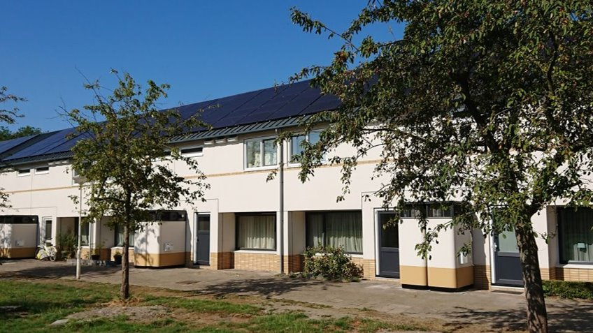

Slide 4
Last week
Tasks:
- Resample data of energy output on an hour basis
- Make a simple forecasting model
- Retrospective Background progress: - Optimised en generalized code for loading-in specific data.

Slide 5
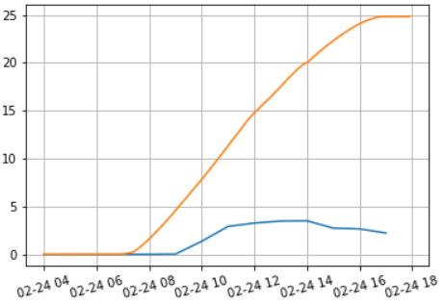
Resampling
Resampled Electric Energy (SmartMeter)
Energy [Kwh]
We took the the difference in Electric Energy column and resampled this data to on hourly basis.
The problem we encounter was that the hourly resampled Electric Energy did not line up with the increase of Electric Energy in the original data.
Date + hour
Electric Energy (original)
hourly resampled Electric Energy

Slide 6
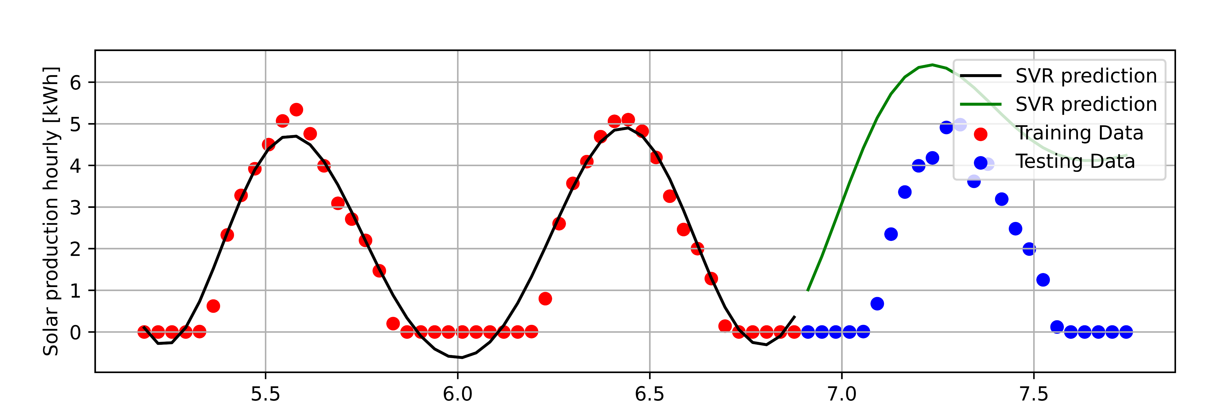
A simple forecasting model
Day 1
Day 2
Prediction Day 3
Day 1
The model is a SVR (Support Vector Regressor)
The model itself chooses which points to use in the regression

Slide 7
Reetro-Retrospective (we used retro.app for this process)
Went well:
To inprove:
We Updated the scrumboard more frequent
We increased productivity by splitting up the tasks better
Cameras are turned on more frequent
We need to better communicate about how our code works to other members
New code must be better structured so it can be reused in the project later on
Scrumboard cards need to be better defined
Agreement from the Team:
Scrumboard cards are going to contain more detial
When a item is done the participants of that item need to explain what they did and how it works to the other memebers of the group
Code wil be commented more frequent

Slide 8
Next week
There is no planning yet, we will make a sprint planning today
Items that will be in this planning:
Solving permission problems on the server
Fix the date time for the weather data

Slide 9

Remarks, Suggestions, Questions

